Slide 1
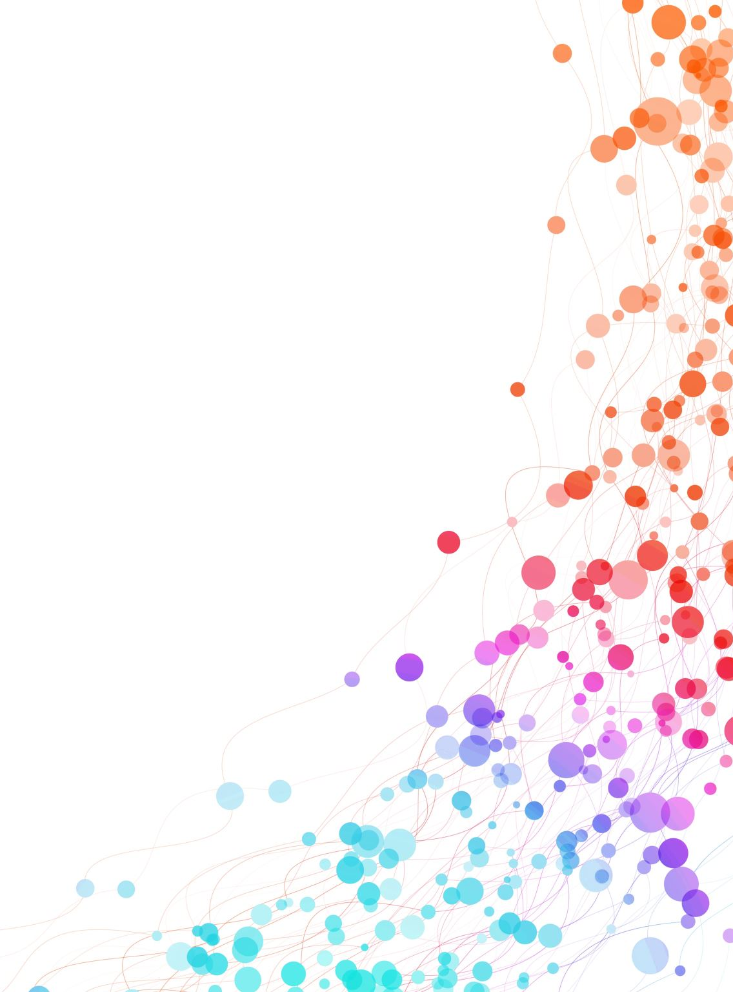
Visual Analytics Group:cyan crabs
Fahmi Chammas 01523267
Ping Chih Tsai 12236246
Suzana Božanić 12025729

Slide 2
Dataset
Crime in the City of Los Angeles from 2020 to present
This dataset reflects incidents of crime in the City of Los Angeles dating back to 2020.
What's in this Dataset?
879K Rows
28 Columns
Each row is a crime incident
And some supporting data such as population, income from the following source:
https://data.lacity.org
https://controllerdata.lacity.org/

Slide 3
Hypothesis
Is Hollywood the safest area in LA?
Are females the most common victims of crime in Los Angeles?
Is there a negative correlation between crimes and the income levels?
Are certain minority groups prone to be victims of some crimes?

Slide 4
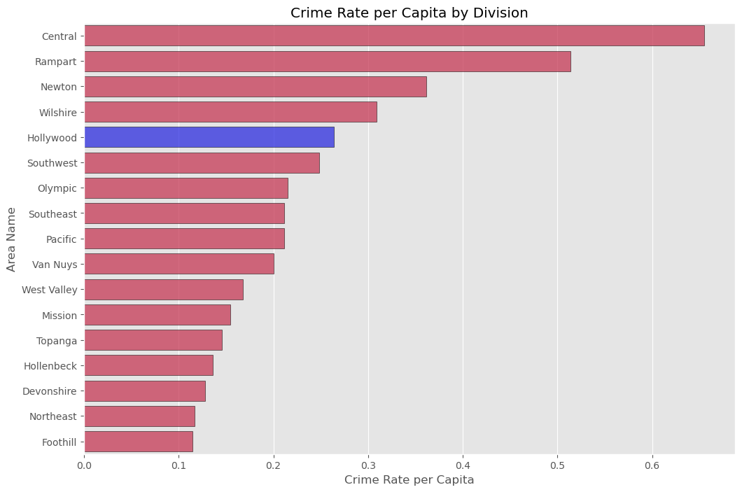
Crime Rate per Capita by Police Division

Slide 5
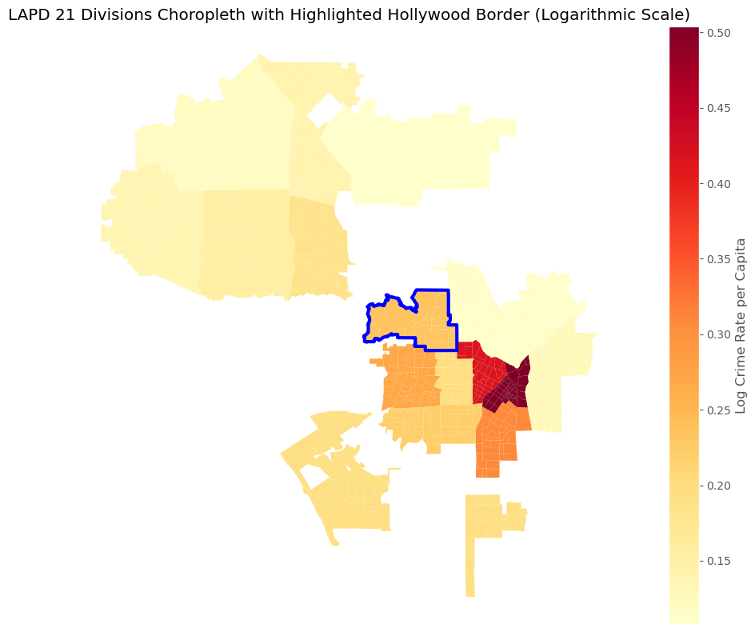
Crime Rate of LAPD 21 Division

Slide 6
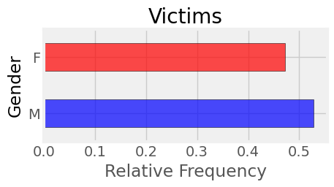
Victims different Genders

Slide 7
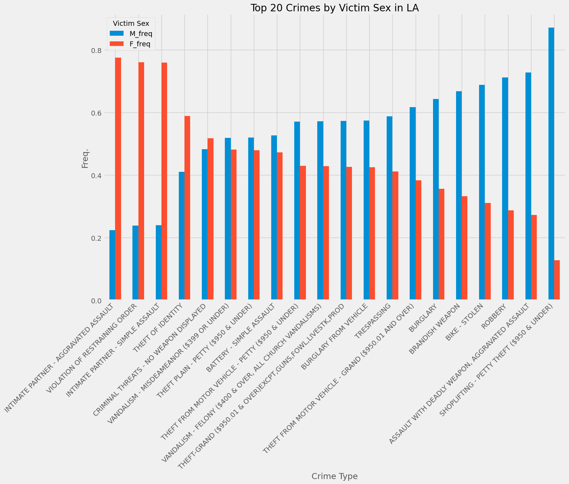
Top 20 Crimes by Victim Sex in LA

Slide 8
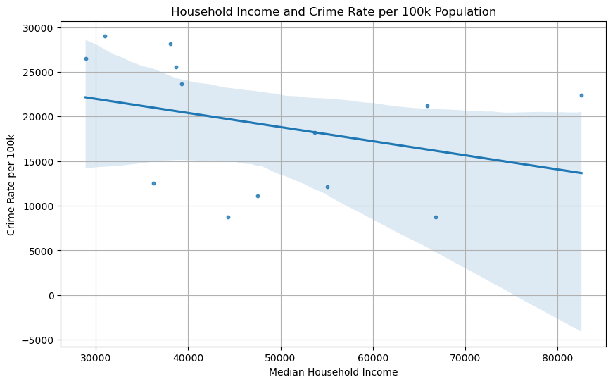
Household Income and Crime Rate per 100K Population

Slide 9
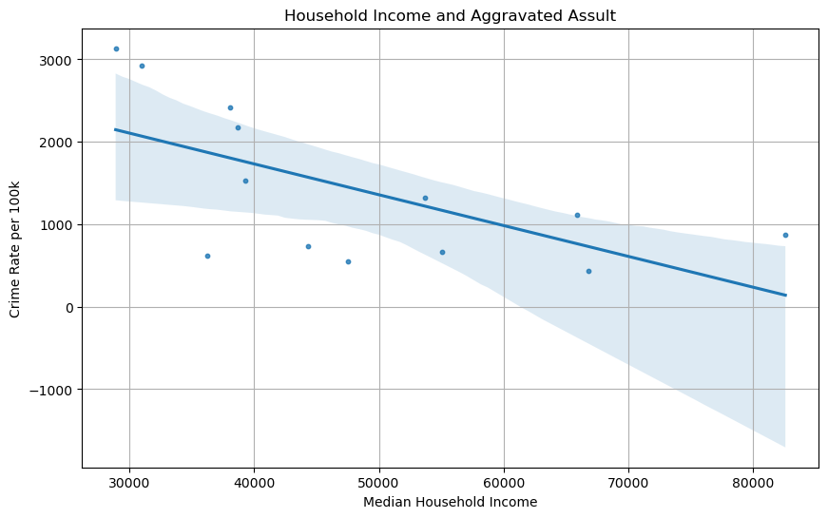
Household Income and Aggravated Assult

Slide 10
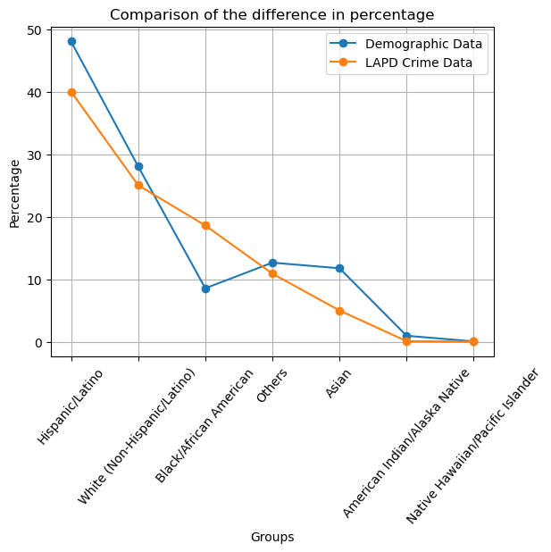
Difference of Demographic and Victim Data

Slide 11
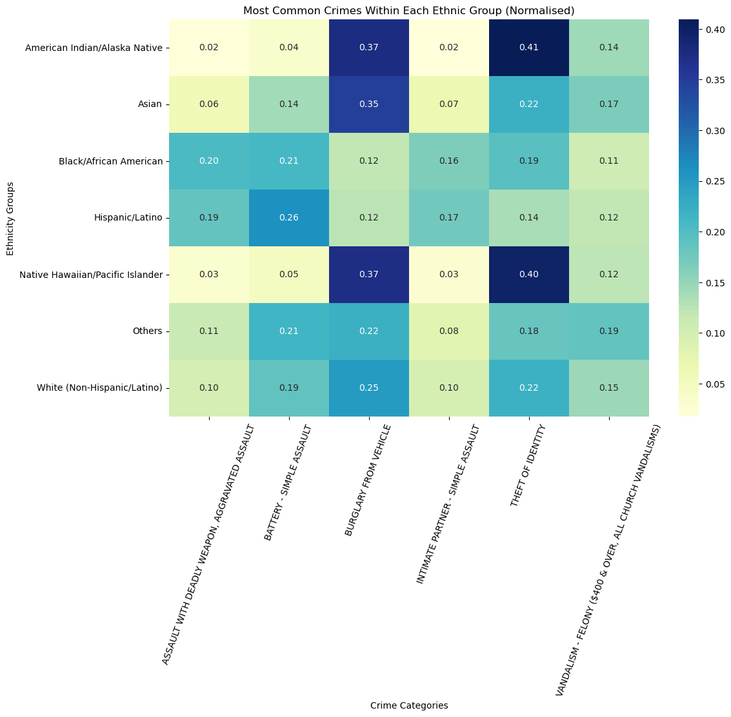
Most Common Crimes within Each Group

